Slide 1
Data Analytics Task 3 - Operation Analytics and Investigating Metric Spike
Saurabh Shrivastav
9574324706

Slide 2
Introduction
Overview:
1. Job Data Analysis
2. Investigating Metric Spikes
Software Used:
MySQL Workbench 8.0 CE

Slide 3
Case Study 1: Job Data Analysis

Slide 4
Creating and Loading Data into job_data Table:
Table Creation:
A table named job_data is created with columns for ds (date), job_id, actor_id, event, language, time_spent, and org.
The ds column stores the date, and other columns store job-related information.
Loading Data:
Data is loaded from a CSV file (job_data.csv) into the job_data table.
Fields are separated by commas, enclosed by double quotes, and each row ends with a newline.
The first row (headers) is ignored.
The ds column is formatted into a DATE type using STR_TO_DATE.
This concise explanation summarizes the purpose of the code and its functionalit

Slide 5
Case Study 1 - Job Data
A. Number of jobs reviewed per hour per day
Objective: Calculate the number of jobs reviewed per hour per day for November 2020.
Query to Find Jobs Reviewed per Hour per Day (November 2020):
Selecting Date and Hour:
DATE(ds) extracts the date from the ds column, so the data is grouped by the day of review.
The HOUR(TIMESTAMP(ds)) extracts the hour of the day when the job was reviewed.
Counting Jobs Reviewed:
COUNT(job_id) counts the number of jobs reviewed per day and hour.
Filtering Data:
Filtering by WHERE clause where the month is November 2020 (ds BETWEEN '2020-11-01' AND '2020-11-30')
Grouping and Ordering:
GROUP BY
clause grouped the data according to date and hour in review
ORDER BY clause ordered it by date and hour as well.

Slide 6
Queries:
SELECT DATE(ds) AS review_date, HOUR(TIMESTAMP(ds)) AS review_hour, COUNT(job_id) AS jobs_reviewed FROM job_dataWHERE ds BETWEEN '2020-11-01' AND '2020-11-30'GROUP BY review_date, review_hourORDER BY review_date, review_hour;
Results:
review_date | review_hour | jobs_reviewed
25-11-2020 | 0 | 1
26-11-2020 | 0 | 1
27-11-2020 | 0 | 1
28-11-2020 | 0 | 2
29-11-2020 | 0 | 1
30-11-2020 | 0 | 2

Slide 7
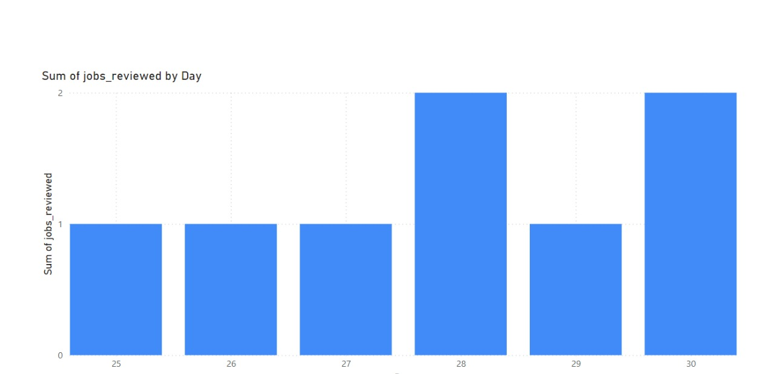
RESULT-:
Job Review Analysis - November 2020
Reviews Reviewed: Data is analyzed between November 1–30, 2020.
Reviews sorted by date and time.
Displays the trends in review activity for the month. Displays the trends in review activity for the month.

Slide 8
Case Study 1 - Throughput
B. Throughput (7-day Rolling Average)
Objective: Calculate the 7-day rolling average of throughput-:
1. Daily Event Count:
The daily_throughput CTE computes the count of events ( COUNT(*) ) per day by grouping the job_data table based on review_date , which is extracted from the ds column.
2.Rolling Average Computation:
The outer SELECT computes the 7-day rolling average of daily events using the
AVG(daily_events) OVER (ORDER BY review_date ROWS 6 PRECEDING) window
function.
It averages the daily_events for each day, taking into account the preceding 6 days ( ROWS 6 PRECEDING ).
3.Displaying Results:
Finally, the result is displaying review_date , the daily_events , and the computed rolling_avg_7_days , which is rounded to 2 decimal places.
4. Ordering the Results:
- The ORDER BY review_date ensures that the data is sorted by the review date.

Slide 9
Queries:
WITH daily_throughput AS (
SELECT
DATE(ds) AS review_date,
COUNT(*) AS daily_events
FROM job_data
GROUP BY review_date
)
SELECT
review_date,
daily_events,
ROUND(AVG(daily_events) OVER (ORDER BY review_date ROWS 6 PRECEDING), 2) AS rolling_avg_7_days
FROM daily_throughput
ORDER BY review_date;
Results:

Slide 10
review_date | daily_events | rolling_avg_7_days
25-11-2020 | 1 | 1
26-11-2020 | 1 | 1
27-11-2020 | 1 | 1
28-11-2020 | 2 | 1.25
29-11-2020 | 1 | 1.2
30-11-2020 | 2 | 1.33

Slide 11
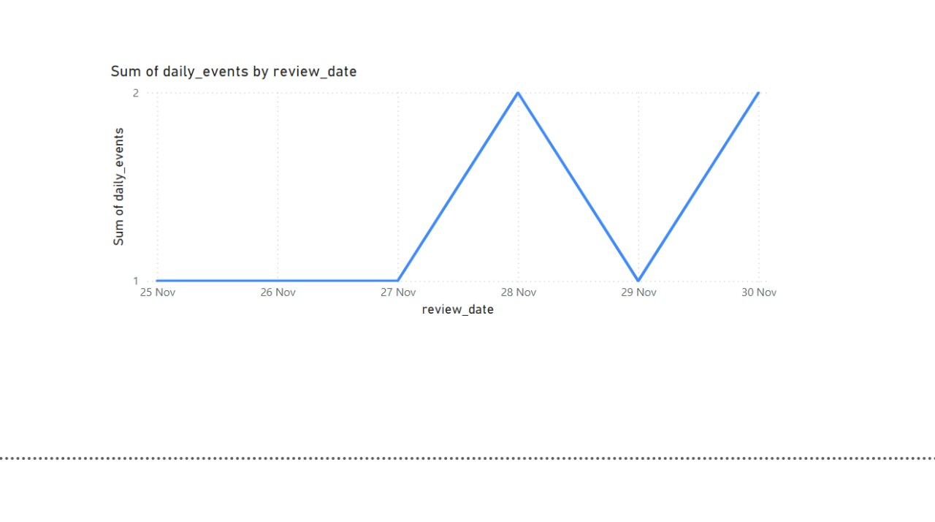
RESULT-:
Daily Throughput Analysis
This query computes daily events (job reviews) and a 7-day rolling average of events for each date.
Data is arranged chronologically to see patterns over time.
Provides insight on daily activity and smoother trends via rolling averages.

Slide 12
Case Study 1 - Percentage Share of Each Language
C. Language Share (Last 30 Days)
Objective: Calculate the percentage share of each language in the last 30 days.
1. Jobs by Language:
The CTE language_counts calculates the count of jobs ( COUNT(*) ) per language, filtered for the date range from November 1 to November 30, 2020. The STR_TO_DATE function ensures the correct date format is applied to the ds column.
2. Total Job Count:
The total_count CTE sums up job counts from the language_counts CTE as a total count of all jobs across all languages
3. Percentage Share
The main query calculates the percentage share in the job count for every language compared to the overall jobs. This is made using the formula (language_count / total_jobs) * 100 , rounding to two decimal places
4. Result output
It shows each language ( language ), its job count ( language_count ), and its percentage share ( percentage_share ).
5. Ordering the Results:
ORDER BY percentage_share DESC sorts the languages by their percentage share in descending order.

Slide 13
Queries:
WITH language_counts AS (
SELECT
language,
COUNT(*) AS language_count
FROM job_data
WHERE STR_TO_DATE(ds, '%Y-%m-%d') BETWEEN '2020-11-01' AND '2020-11-30'
GROUP BY language
),
total_count AS (
SELECT
SUM(language_count) AS total_jobs
FROM language_counts
)
SELECT
lc.language,
lc.language_count,
ROUND((lc.language_count / tc.total_jobs) * 100, 2) AS percentage_share
FROM
language_counts lc,
total_count tc
ORDER BY
percentage_share DESC;

Slide 14
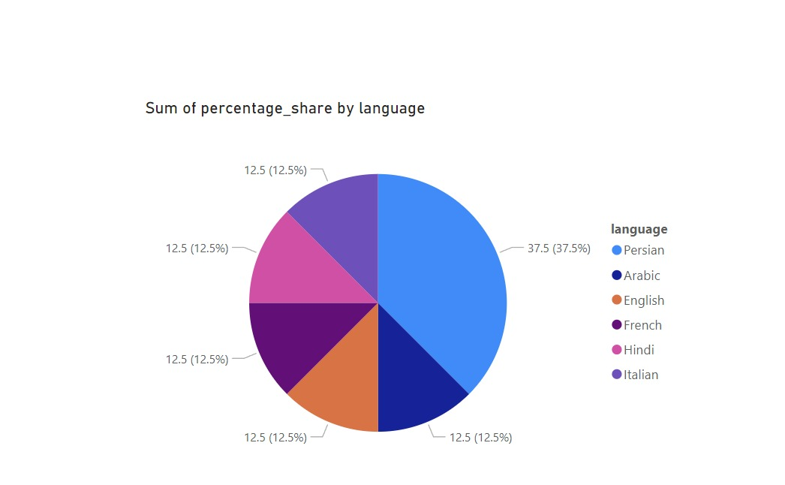
Results:
language | language_count | percentage_share
Persian | 3 | 37.5
English | 1 | 12.5
Arabic | 1 | 12.5
Hindi | 1 | 12.5
French | 1 | 12.5
Italian | 1 | 12.5

Slide 15
RESULT-:
Language Distribution Analysis - November 2020
Analyzed job data for November 2020 to determine the distribution of jobs by language.
Key Outputs:
Language Count: Number of jobs by language:.
Percentage Share: Contribution of each language to total jobs, sorted in descending order.
It highlights the dominant languages in job reviews for the period.

Slide 16
Case Study 1 - Duplicate Rows
D. Displaying Duplicate Rows
Objective: Find duplicate rows in the table.
Query to Find Duplicates on the job_data Table:
1. Using ROW_NUMBER() Function:
ROW_NUMBER() is applied together with a PARTITION BY clause to give a unique row number for each combination of job_id , actor_id , event , language , time_spent , org , and ds .
This guarantees that every set of duplicate records gets a different number, starting from 1 of any group.
2. Filtering Duplicates
Then the query wraps the results in a subquery and filters out the rows where the row_num is greater than 1.
This identifies all rows that are duplicates (i.e., multiple entries with the same values for the specified columns).
3. Final Output:
The query will return all the duplicate rows where a combination of values more than once appears in the job_data table.

Slide 17
Queries:
SELECT *
FROM
(
SELECT *, ROW_NUMBER()OVER(PARTITION BY job_id) AS row_num
FROM job_data
) a
WHERE row_num>1;
Results:
ds | job_id | actor_id | event | language | time_spent | org | row_num
28-11-2020 | 23 | 1005 | transfer | Persian | 22 | D | 2
26-11-2020 | 23 | 1004 | skip | Persian | 56 | A | 3

Slide 18
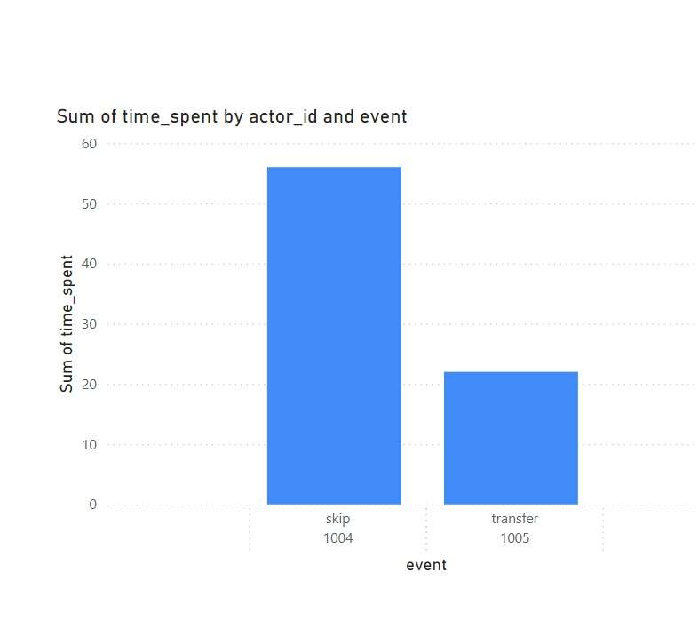
Result Achieved
Detected duplicate job entries in the dataset for cleanup.

Slide 19
Case Study 2: Investigating Metric Spike

Slide 20
1. Define Tables:
users table : Store the user details along with their company_id, selected language, and activation statuses.
events1 table: Store the events associated data, including the event user_id, type and name, and more.
user_events table:Store user-specific event action names and types.
2.Alter Data Types:
Modify all occurred_at columns in both events1 and user_events table to VARCHAR(255). This would keep the date-time value stored as a string
3. Load Data:
Use LOAD DATA INFILE to load data from CSV files into the corresponding tables:
users.csv into users
events.csv into events1
email_events.csv into user_events
4. Query Data:
Use SELECT * FROM users to view the loaded data.

Slide 21
Case Study 2 - User Engagement
A. Weekly User Engagement
Objective: Calculate weekly user engagement.
Identify the goal: Count distinct users per week based on the occurred_at timestamp.
Week number: Use WEEK(occurred_at) to obtain the week number.
Count distinct users: Use COUNT(DISTINCT user_id) to determine the unique users for every week.
Group by week: Use GROUP BY week_number to group the results by week.
Perform the query: Retrieve the data of interest from the OPERATIONS_analytics.events1 table.

Slide 22
week_number | number_of_users
17 | 663
18 | 1068
19 | 1113
20 | 1154
21 | 1121
22 | 1186
23 | 1232
24 | 1275
25 | 1264
26 | 1302
27 | 1372
28 | 1365
29 | 1376
30 | 1467
31 | 1299
32 | 1225
33 | 1225
34 | 1204
35 | 104
Queries:
SELECT WEEK(occurred_at) AS week_number, COUNT(DISTINCT user_id) AS number_of_usersFROM OPERATIONS_analytics.events1GROUP BY week_number;
Results:

Slide 23
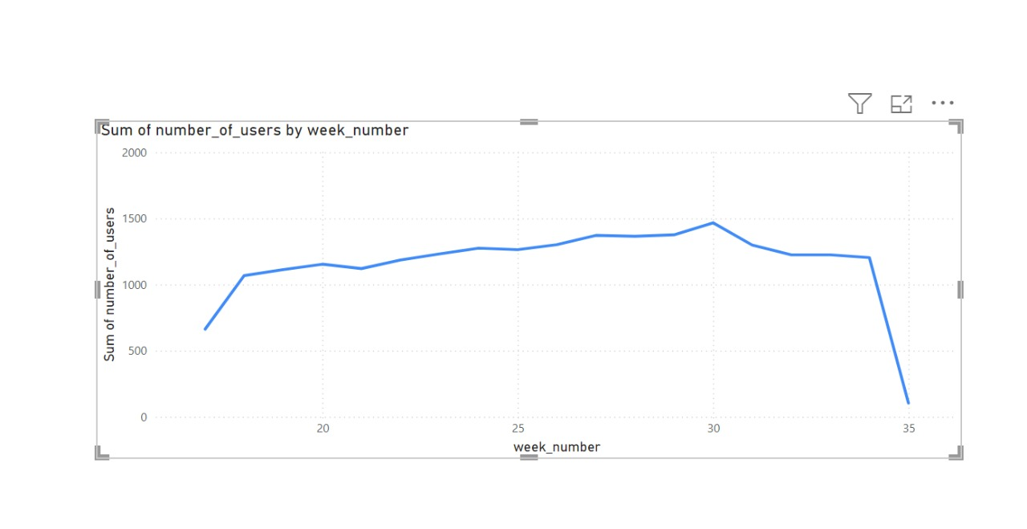
Result:
Returns the number of unique users for each week, sorted by the occurred_at timestamp.
The data is aggregated by the week number; it counts the unique user_id for each week so that user engagement over time can be analyzed.
Understanding user activity patterns on a weekly basis is facilitated through the result.

Slide 24
Case Study 2 - User Growth
B. User Growth Over Time
Objective: Calculate user growth (number of active users per week).
Extract Year and Week: EXTRACT() is used to retrieve the year and week number from the field activated_at.
Count of Active Users per Week : COUNT(DISTINCT user_id) is the number of active users by distinct user_id every week.
Cumulative Active Users: SUM(COUNT(.)) OVER() computes the running total of active users from the beginning up to the current week.
Grouping: The results are grouped by year and no_of_weeks to compute weekly metrics, and ordered by year and week.

Slide 25
Queries:
SELECT
EXTRACT(YEAR FROM STR_TO_DATE(activated_at, '%Y-%m-%d')) AS year,
EXTRACT(WEEK FROM STR_TO_DATE(activated_at, '%Y-%m-%d')) AS no_of_weeks,
COUNT(DISTINCT user_id) AS no_of_active_users,
SUM(COUNT(DISTINCT user_id)) OVER (ORDER BY
EXTRACT(YEAR FROM STR_TO_DATE(activated_at, '%Y-%m-%d')),
EXTRACT(WEEK FROM STR_TO_DATE(activated_at, '%Y-%m-%d'))
ROWS BETWEEN UNBOUNDED PRECEDING AND CURRENT ROW) AS cumm_active_users
FROM users
GROUP BY year, no_of_weeks
ORDER BY year, no_of_weeks;
Results:
The result is stored in the g drive as the size is very long .
https://drive.google.com/file/d/1x5Wm28Zbp4Rq8-4OVYVKCJhFpwEWaV1R/view?usp=drive_link
Overall the output is :
count
count 9381

Slide 26
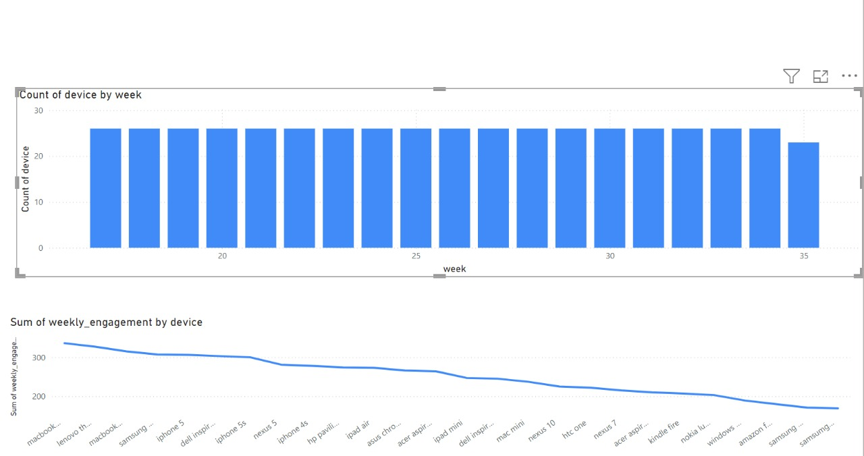
RESULT-:
Calculated weekly active users (no_of_active_users) group by year and week.
Computed cumulative active users (cumm_active_users) to track user growth over time.
Insights give an obvious trend in user activation and engagement week after week.
This enables effective monitoring of user growth and activity patterns.

Slide 27
Case Study 2 - Weekly Retention
C. Weekly Retention (Sign-up Cohort)
Objective: Calculate weekly retention of users after sign-up.
1.Cohort Date Extraction:
The signup_cohort CTE extracts the cohort_date from the created_at field, which is of type date ( '%Y-%m-%d' ).
This is the date on which users first signed up.
2. Activity Week Calculation:
The weekly_activity CTE pulls the activity_week from the occurred_at column using YEARWEEK() .
It aggregates users by activity week.
3. Join Signup Cohort with Weekly Activity:
The last query joins signup_cohort and weekly_activity CTEs on user_id to track the date of signing up for users with their weekly activities.
It computes retained users by counting unique users who have an activity in the same week they joined up.
4. Results:
The output will display cohort_date , its corresponding activity_week , and the count of retained_users for each week after sign-up.

Slide 28
Queries:
WITH signup_cohort AS (
SELECT
user_id,
DATE(STR_TO_DATE(created_at, '%Y-%m-%d')) AS cohort_date -- Adjust format if necessary
FROM users
),
weekly_activity AS (
SELECT
user_id,
YEARWEEK(STR_TO_DATE(occurred_at, '%Y-%m-%d')) AS activity_week -- Adjust format if necessary
FROM events1
GROUP BY user_id, activity_week
)
SELECT
cohort_date,
activity_week,
COUNT(DISTINCT wa.user_id) AS retained_users
FROM signup_cohort sc
JOIN weekly_activity wa ON sc.user_id = wa.user_id
GROUP BY cohort_date, activity_week;
Results:
As the output is large I have given the result in gdrive . The link is –https://drive.google.com/file/d/1RXSfZHfwkqtycqGEDpSw7KZL1VJ7B6TD/view?usp=drive_link

Slide 29
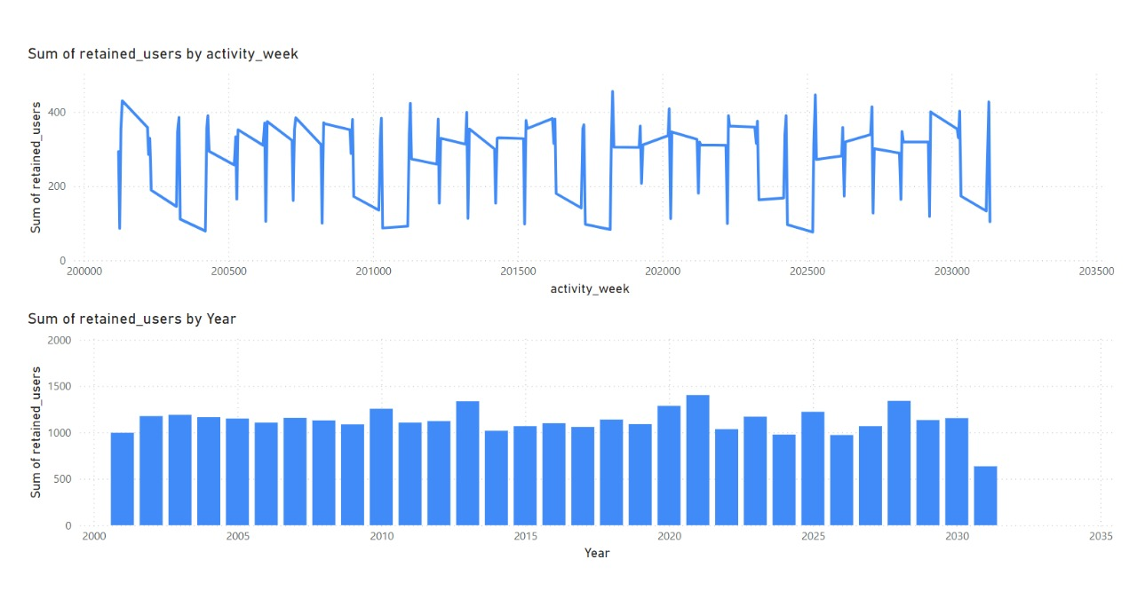
RESULT-:
SQL query calculates the weekly retention of users based on their sign-up cohort. The result provides:
Cohort Date: The week when users signed up.
Activity Week: The week(s) in which users were actively engaged after their sign-up.
Retained Users: The count of distinct users who were active in the product after their sign-up week.

Slide 30
Case Study 2 - Weekly Engagement (Per Device)
D. Weekly Engagement (Per Device)
Objective: Calculate weekly engagement by device.
In the query, YEAR(occurred_at) and WEEK(occurred_at) are used to extract the year and the week number from the occurred_at timestamp.
This lets you group your data by year and week for an even finer view of how engagement goes over time.
Device:
This query groups your data by device to track the engagement of each type separately.
Weekly Engagement Counting:
The COUNT(DISTINCT event_name) is a count of the distinct events (i.e., kinds of user interactions) by week, device, and year.
This shows the number of different events that occurred every week on every device.
Filtering Null Dates:
WHERE occurred_at IS NOT NULL eliminates any rows in which occurred_at was null, ensuring only valid dates are counted.
Grouping and Ordering:
GROUP BY year, week, device.
The ORDER BY clause sorts results by year, week, and device to provide a clear, time-ordered view of engagement per device.

Slide 31
Queries:
SELECT
YEAR(occurred_at) AS year,
WEEK(occurred_at) AS week,
device,
COUNT(DISTINCT event_name) AS weekly_engagement
FROM
events1
WHERE
occurred_at IS NOT NULL
GROUP BY
YEAR(occurred_at), WEEK(occurred_at), device
ORDER BY
year, week, device;
Results:
As the result is very big I have included the gdrive link result.
https://drive.google.com/file/d/1fCrYGhjvydwXTxE5RCjlhS7ahXJNDhZg/view?usp=drive_link

Slide 32
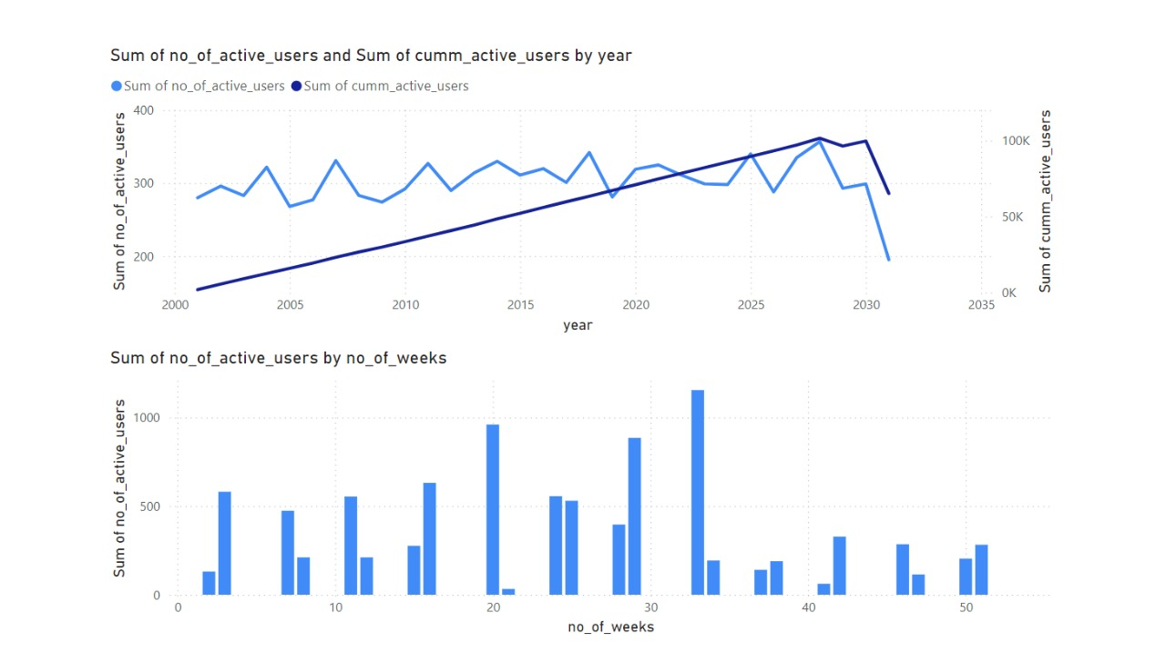
RESULT-:
Measured weekly user engagement by counting distinct events (weekly_engagement) across various devices.
Group the data by year, week, and device type for closer analysis.
Engagement trends identified based on device usage over time.
This enables understanding of platform-specific engagement and optimizing for user behavior.

Slide 33
Case Study 2 - Email Engagement Metrics
E. Email Engagement
Objective: Calculate email engagement metrics (open rate, click rate).
This query calculates the email opening rate and email clicking rate by first categorizing user actions into email_sent, email_opened, and email_clicked.
It then calculates the percentage of emails opened and clicked out of those sent.
The formula for each rate is the sum of respective actions divided by the total number of emails sent, expressed as a percentage.

Slide 34
Queries:
SELECT
100.0*SUM(CASE when email_cat = 'email_opened' then 1 else 0 end)/SUM(CASE when
email_cat = 'email_sent' then 1 else 0 end) as email_opening_rate,
100.0*SUM(CASE when email_cat = 'email_clicked' then 1 else 0 end)/SUM(CASE when
email_cat = 'email_sent' then 1 else 0 end) as email_clicking_rate
FROM
(
SELECT
*,
CASE
WHEN action in ('sent_weekly_digest','sent_reengagement_email')
then 'email_sent'
WHEN action in ('email_open')
then 'email_opened'
WHEN action in ('email_clickthrough')
then 'email_clicked'
end as email_cat
from operations_analytics.user_events
) a;

Slide 35
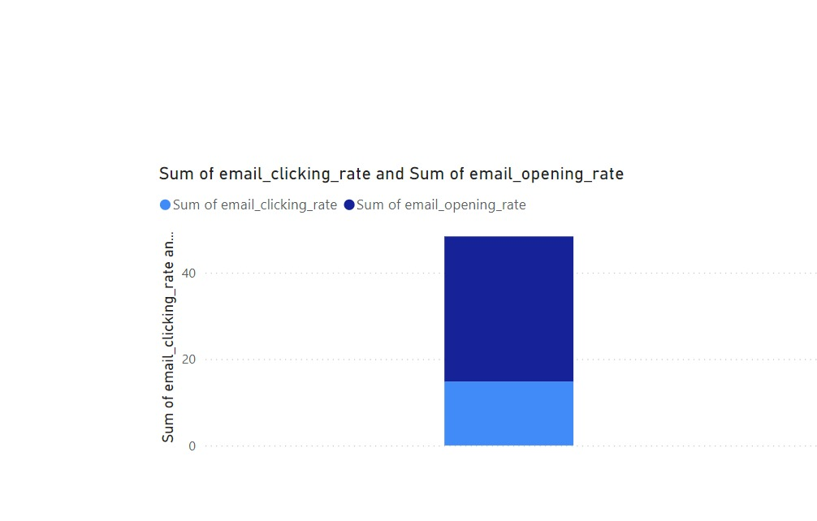
Result-:
email_opening_rate | email_clicking_rate
33.58339 | 14.78989

Slide 36
RESULT-:
Calculated key email performance metrics:
Email Opening Rate: Percentage of sent emails that were opened.
Email Clicking Rate: The percentage of emails sent that were clicked.
Classified user actions as sent, opened, and clicked email events for detailed analysis.
This gives a glimpse into the effectiveness of email campaigns and user engagement.

